Slide 1
The engine of dual VET
Cooperation between stakeholders from
trade and industry, the state and society
Vocational education
and training in Germany
German Office for International Cooperation in Vocational Education and Training

Slide 2
Contents
The engine of dual VET
Vocational education and training – stakeholders and their interests
  Employers and organisations of trade and industry
  Employees
  Public sphere and the state
Stakeholders act together to shape vocational education and training
  Development of the dual VET system
  Development of standards
  Supervision of training
  Examination and certification
Summary
Notes:
1. >>> Examination boards with equal representation, jointly adopted training standards, joint governance of the system at all levels
2. >>> Around 70% of training is company based
3. >>> VET standards, certificate issued by the chamber
4. >>> At and from the companies, state-employed teachers at the vocational schools
5. >>> Data Reports, Report on Vocational Education and Training, training standards (BIBB)

Slide 3
The engine of dual VET
Vocational education and training –
stakeholders and their interests

Slide 4





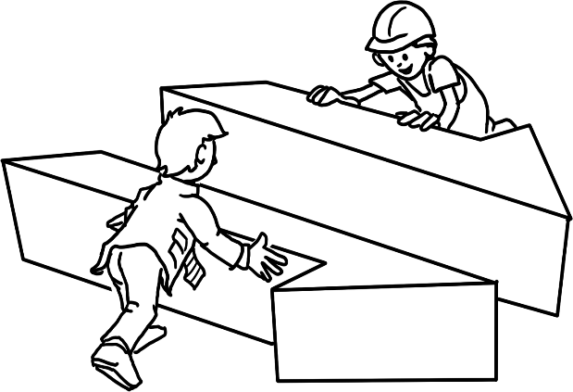
Summary
“Competent bodies”
Interests of the employers and of
organisations of trade and industry
Public
interests/
state
Interests of the employees
“Social partners”

Slide 5
Employers and organisations of trade and industry
Attitudes
“Qualified workers are crucial for productivity and competitiveness.”
“Vocational education is an important way for us to find qualified and
loyal staff.”
“We are prepared to provide training ourselves.”
“We want to help shape the regulation of company-based training.”
Notes:
Supplementary information
> A total of approximately 53% of the population have commenced a programme of dual vocational education and training at some point during their life.
> The employment rate is high. Around 96% of all persons completing VET are able to secure employment (as opposed to 82% of those without a vocational qualification).
The positive effect
Youth unemployment in Germany is only about 5%.

Slide 6
Employers and organisations of trade and industry
Demands
“Vocational education and training must be aligned to the needs of
the company.”
“We require young people to display the necessary apprenticeship
entry maturity for company-based training.”
“Training allowances should be significantly lower than the salaries of skilled workers.”
“Vocational schools should impart occupational theory and practice in line with our needs.”
Notes:
Supplementary information
> A total of approximately 53% of the population have commenced a programme of dual vocational education and training at some point during their life.
> The employment rate is high. Around 96% of all persons completing VET are able to secure employment (as opposed to 82% of those without a vocational qualification).
The positive effect
Youth unemployment in Germany is
only about 5%.

Slide 7











Employers and organisations of trade and industry
Interests are articulated via
Umbrella association
Employer associations
Sectoral associations
(e.g. industry and the craft trades)
Chambers
Notes:
Supplementary information
> A total of approximately 53% of the population have commenced a programme of dual vocational education and training at some point during their life.
> The employment rate is high. Around 96% of all persons completing VET are able to secure employment (as opposed to 82% of those without a vocational qualification).
The positive effect
Youth unemployment in Germany is only about 5%.

Slide 8

Employees
Attitudes
  “Vocational education and training is important for the employment and income of workers.”
  “The aim of VET is the acquisition of comprehensive employability skills.”
  “VET must be of high quality and must impart both professional practice and ‘soft skills’.”
  “The rights of trainees at the company must be protected.”
Notes:
Supplementary information
> A total of approximately 53% of the population have commenced a programme of dual vocational education and training at some point during their life.
> The employment rate is high. Around 96% of all persons completing VET are able to secure employment (as opposed to 82% of those without a vocational qualification).
The positive effect
Youth unemployment in Germany is only about 5%.

Slide 9
Employees
Demands
  “Companies should offer training opportunities to subsequent generations.”
  “Companies should not be permitted to deploy trainees as cheap labour.”
  “Company-based training should be inspected by independent institutions.”
  “Vocational education and training should be holistic and should
  open up career opportunities.”
Notes:
Supplementary information
> A total of approximately 53% of the population have commenced a programme of dual vocational education and training at some point during their life.
> The employment rate is high. Around 96% of all persons completing VET are able to secure employment (as opposed to 82% of those without a vocational qualification).
The positive effect
Youth unemployment in Germany is only about 5%.

Slide 10










Employees
Interests are articulated via
  German Trade Union Confederation
  Sectoral trade unions
  Works councils
  (Professional associations)
Notes:
Supplementary information
> A total of approximately 53% of the population have commenced a programme of dual vocational education and training at some point during their life.
> The employment rate is high. Around 96% of all persons completing VET are able to secure employment (as opposed to 82% of those without a vocational qualification).
The positive effect
Youth unemployment in Germany is only about 5%.

Slide 11
Public sphere and the state
Attitudes
  “Qualified skilled workers are important for the economy
  and for society.”
  “We create a framework and platform for employers and
  employees to commit to vocational education and training.”
  “We foster the vocational education and training system via governance structures, research, innovation and guidance.”
  “Strong VET enables young people to obtain good development prospects within society.”
  “Company-based training forms part of the education system.”
  “We make vocational school-based training available.”
Notes:
The impetus for development and updating of training standards emerges from the companies and chambers. They are best placed to understand what new knowledge is required.
Further tasks
> Support companies in their endeavours to recruit trainees
> Mediation in the event of disagreements between trainees and companies
> Trade and industry invests €8.4 billion annually in vocational education and training

Slide 12
Public sphere and the state
Demands
  “Employers and employees should work together to
  actively shape vocational education and training.”
  “Employers should offer training opportunities.”
Notes:
The impetus for development and updating of training standards emerges from the companies and chambers. They are best placed to understand what new knowledge is required.
Further tasks
> Support companies in their endeavours to recruit trainees
> Mediation in the event of disagreements between trainees and companies
> Trade and industry invests €8.4 billion annually in vocational education and training

Slide 13




















Public sphere and the state
Interests are articulated via
  Federal Government
  (federal ministries)
  16 federal states
  (state governments)
Notes:
The impetus for development and updating of training standards emerges from the companies and chambers. They are best placed to understand what new knowledge is required.
Further tasks
> Support companies in their endeavours to recruit trainees
> Mediation in the event of disagreements between trainees and companies
> Trade and industry invests €8.4 billion annually in vocational education and training

Slide 14


Conclusion
Strong stakeholders assume a joint
commitment to vocational education
and training
Employers, employees and the state represent different collective interests in vocational education
and training in a manner which is highly organised and competent.
Notes:
Supplementary information:
The process of agreement and adoption of new training regulations takes place under the lead management of the Federal Institute for Vocational Education and Training.
Trade and industry and the social partners are involved across the entire procedure.

Slide 15
Conclusion
Strong stakeholders assume a joint
commitment to vocational education
and training.
Commitment is based on joint principles.
“We wish to govern VET collectively.”
“We share responsibility for vocational education and training.”
“Vocational education and training should be practice-related, of high quality and standardised.”
“Standards in VET must be requirements oriented and current.”
“Vocational education and training is a prerequisite for competitiveness on the global market.”
Notes:
Supplementary information:
The process of agreement and adoption of new training regulations takes place under the lead management of the Federal Institute for Vocational Education and Training.
Trade and industry and the social partners are involved across the entire procedure.

Slide 16
The engine of dual VET
Stakeholders act together to shape
dual vocational education and training

Slide 17


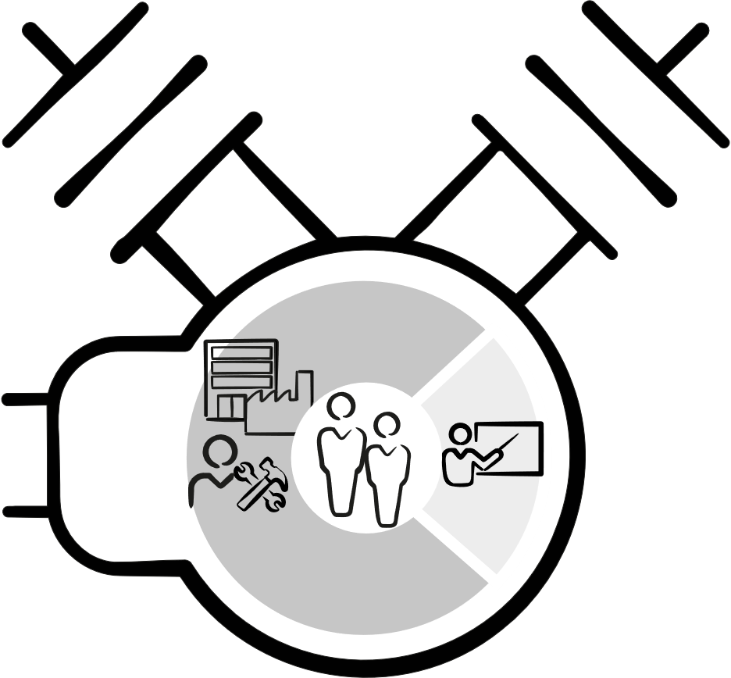

Summary
Strong commitment
within the scope of dual
vocational education and training
Co-determination and cooperation is conveyed by formal mechanisms (integration of interests)
  Laws
  Institutions
  Committees/panels
The engine of dual VET
Notes:
Detailed information
> Financing provided by the state is around €4,6 billion. Over €3,4 billion of this is spent on 1,550 vocational schools, and around €1.17 billion is earmarked for governance, monitoring and support measures.
> The state passes the Vocational Training Act

Slide 18



Summary
1. Development of the
dual VET system
4. Examination and
certification
2. Development of
standards
3. Implementation
of training
Notes:
Summarise the preceding slides once more if necessary.
Three main stakeholders participate equally in agreeing on the fundamental standards underlying vocational education and training.
These standards accord to specific requirements from the world of work.

Slide 19

Guidelines
Coordinate learning venues
Support cooperation between stakeholders
Ensure the uniformity of VET nationwide

Slide 20



Development of the dual VET system
Interlinked by
Employers
The state
National
Committee
(Board)
Employers/organisations of trade and
industry wish to help shape the
general conditions governing
VET
The state defines
the framework and pursues regulatory policy interests
Trade unions wish
to help shape the
general conditions governing VET
Legal basis
Vocational Training Act § 92
Crafts and Trades Regulation Code § 38
Employees
Notes:
Supplementary information
> Maximum duration of further development and implementation of standards is 1 year.
> Standards are dynamically adjusted to the requirements of the world of work at both learning venues.
> BIBB conducts continuous research into the shift of work and training. The findings of this research inform the process.

Slide 21








Development of the dual VET system
BIBB
Board
Honorary olunteers (Unpaid)
4 years
  Principle of consensus
  Regular
  meetings
Members
Deputy members
comprising employers, employees, Federal Government and federal state governments
(so-called ‘four benches’)
Notes:
Supplementary information
> Maximum duration of further development and implementation of standards is 1 year.
> Standards are dynamically adjusted to the requirements of the world of work at both learning venues.
> BIBB conducts continuous research into the shift of work and training. The findings of this research inform the process.

Slide 22
Development of the dual VET system
Examples of tasks
Advises the Federal Government on issues relating to VET
Submits recommendations for practice (e.g. with regard
to standardised implementation of the Vocational Training Act)
Provides an official response to legal ordinances promulgated by the Federal Government (e.g. training regulations)
Gives official responses to policies adopted by the Federal Government
Adopts resolutions regarding the affairs of BIBB (e.g. budget, research)
BIBB
Board
Notes:
Supplementary information
> Maximum duration of further development and implementation of standards is 1 year.
> Standards are dynamically adjusted to the requirements of the world of work at both learning venues.
> BIBB conducts continuous research into the shift of work and training. The findings of this research inform the process.

Slide 23
Development of the dual VET system
Relevance
Sets out agreed positions of the VET stakeholders
Central coordinating mechanism of dual VET at federal level (“Parliament of Vocational Education and Training”)
Forum in which stakeholders govern the VET system jointly
BIBB
Board
Notes:
Supplementary information
> Maximum duration of further development and implementation of standards is 1 year.
> Standards are dynamically adjusted to the requirements of the world of work at both learning venues.
> BIBB conducts continuous research into the shift of work and training. The findings of this research inform the process.

Slide 24
Development of standards
Interlinked by
Employers
The state
Expert
groups
Organisations set out the needs of employers/trade and industry
Government
sets out needs
and enacts
standards
Trade unions set out
the needs
of employees
Legal basis
Vocational Training Act § 4
Employees
Notes:
Supplementary information
> Maximum duration of further development and implementation of standards is 1 year.
> Standards are dynamically adjusted to the requirements of the world of work at both learning venues.
> BIBB conducts continuous research into the shift of work and training. The findings of this research inform the process.

Slide 25



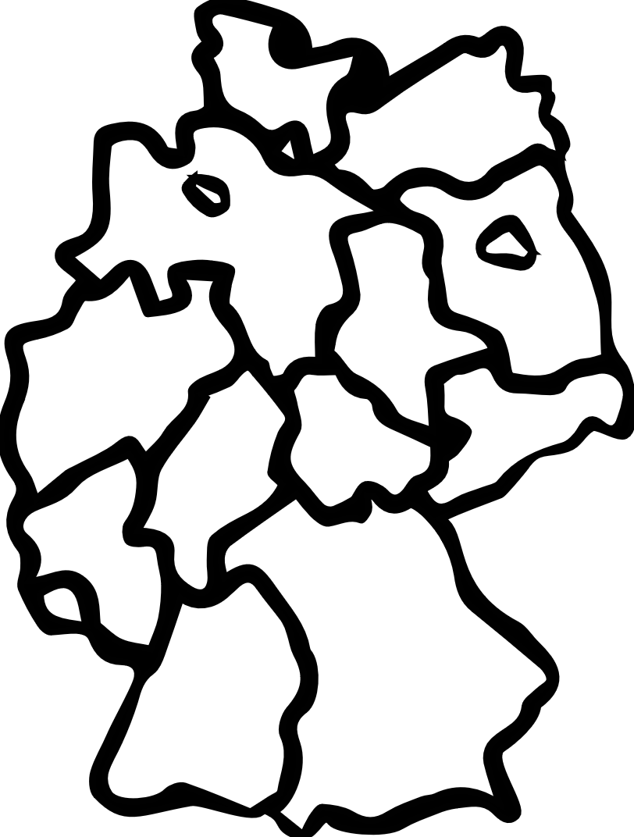
Development of standards
BIBB representative manages,
organises and chairs the process;
provides technical input
(“occupational expert”)
Committee formed for new training occupation/training occupation to be updated (temporary, not permanent)
BIBB
Expert
groups
Trade and industry and
employees delegate own experts
Federal Government and federal states become involved
Comprising experts with
experience of practice and theory
Notes:
Supplementary information
> Maximum duration of further development and implementation of standards is 1 year.
> Standards are dynamically adjusted to the requirements of the world of work at both learning venues.
> BIBB conducts continuous research into the shift of work and training. The findings of this research inform the process.

Slide 26
Development of standards
Examples of tasks
Develop and update training regulations for company-based training
Advise stakeholders on the implementation of the training regulations
and on coordinating them with development of the framework curricula (vocational school)
Expert
groups
Notes:
Supplementary information
> Maximum duration of further development and implementation of standards is 1 year.
> Standards are dynamically adjusted to the requirements of the world of work at both learning venues.
> BIBB conducts continuous research into the shift of work and training. The findings of this research inform the process.

Slide 27
Development of standards
Relevance
Mechanism via which stakeholders jointly develop standards
which reflect requirements of the world of work
Standards developed are accepted and recognised by those implementing them (companies, trainers, trainees)
Expert
groups
Notes:
Supplementary information
> Maximum duration of further development and implementation of standards is 1 year.
> Standards are dynamically adjusted to the requirements of the world of work at both learning venues.
> BIBB conducts continuous research into the shift of work and training. The findings of this research inform the process.

Slide 28
Quality assurance
Interlinked by
Employers
The state
  Committees
  and competent bodies
  across the entire country
Employers provide
training at the company
based on
state standards
State supervises,
finances and
implements school-based
VET
Works councils monitor training at large companies
Legal basis
Vocational Training Act §§ 77 ff.
Laws of the federal states
Employees
Notes:
Supplementary information
> Maximum duration of further development and implementation of standards is 1 year.
> Standards are dynamically adjusted to the requirements of the world of work at both learning venues.
> BIBB conducts continuous research into the shift of work and training. The findings of this research inform the process.

Slide 29







Quality assurance
  Federal
  State
  VET
  Committee
  Responsibility rests
  with federal state government
Honorary volunteers (unpaid)
4 years
Majority principle
  6 representatives of employers, employees and the federal state government
Notes:
Supplementary information
> Maximum duration of further development and implementation of standards is 1 year.
> Standards are dynamically adjusted to the requirements of the world of work at both learning venues.
> BIBB conducts continuous research into the shift of work and training. The findings of this research inform the process.

Slide 30
Quality assurance
Examples of tasks
  Advises the federal state government on issues relating to VET
  Works towards achieving constant quality development in VET
  Federal
  State
  VET
  Committee
Notes:
Supplementary information
> Maximum duration of further development and implementation of standards is 1 year.
> Standards are dynamically adjusted to the requirements of the world of work at both learning venues.
> BIBB conducts continuous research into the shift of work and training. The findings of this research inform the process.

Slide 31
Quality assurance
Relevance
  Sets out agreed positions of the stakeholders, particularly with regard to development and implementation of school-based VET
  in the region
  Mechanism via which the stakeholders help jointly to shape VET policy in the federal state and to coordinate implementation of vocational school-based and company-based training
  Federal
  State
  VET
  Committee
Notes:
Supplementary information
> Maximum duration of further development and implementation of standards is 1 year.
> Standards are dynamically adjusted to the requirements of the world of work at both learning venues.
> BIBB conducts continuous research into the shift of work and training. The findings of this research inform the process.

Slide 32

Quality assurance
  Responsibility rests with
  competent bodies (chambers,
  ministries etc.
  VET
  Committees
Honorary volunteers (unpaid)
4 years
Majority principle
  6 representatives of employers, employees and vocational schools
Notes:
Supplementary information
> Maximum duration of further development and implementation of standards is 1 year.
> Standards are dynamically adjusted to the requirements of the world of work at both learning venues.
> BIBB conducts continuous research into the shift of work and training. The findings of this research inform the process.

Slide 33
Quality assurance
Examples of tasks
Consult and provide information on all important issues relating
to vocational education and training
Adopt legal ordinances for the implementation of VET
  Required to work towards achieving constant quality development
  in VET
  Ensures implementation of the recommendations made by the
  Federal State Committee
  VET
  Committees
Notes:
Supplementary information
> Maximum duration of further development and implementation of standards is 1 year.
> Standards are dynamically adjusted to the requirements of the world of work at both learning venues.
> BIBB conducts continuous research into the shift of work and training. The findings of this research inform the process.

Slide 34
Quality assurance
Relevance
Sets out agreed positions, in particular with regard to regulation of company-based VET (suitability of training centres, examination etc.)
Mechanism via which the stakeholders jointly ensure the quality
of dual VET for certain sectors (craft trades, trade and industry, agriculture etc.) in the region
  VET
  Committees
Notes:
Supplementary information
> Maximum duration of further development and implementation of standards is 1 year.
> Standards are dynamically adjusted to the requirements of the world of work at both learning venues.
> BIBB conducts continuous research into the shift of work and training. The findings of this research inform the process.

Slide 35

Quality assurance
Competent bodies (mostly chambers)
What are competent bodies?
  Regulated by law (Vocational Training Act/Crafts and Trades Regulation Code)
  Assumption of public/sovereign tasks in connection with dual vocational education and training
  Numerous competent bodies in each federal state (established at
  a regional level)
  Competent bodies based at organisations which represent a sector
Notes:
Supplementary information
> Maximum duration of further development and implementation of standards is 1 year.
> Standards are dynamically adjusted to the requirements of the world of work at both learning venues.
> BIBB conducts continuous research into the shift of work and training. The findings of this research inform the process.

Slide 36
Quality assurance
Tasks of the competent bodies/chambers
  Monitor company-based training, e.g. suitability of company and aptitude of trainers for execution of training
  Maintain the register of vocational education and training contracts
  Set up VET Committee and examination boards and enact the resolutions adopted by the committees
  Issue final certificates
  Recognition of qualifications acquired abroad
  Advise companies (usually via “training advisors”)
Notes:
Supplementary information
> Maximum duration of further development and implementation of standards is 1 year.
> Standards are dynamically adjusted to the requirements of the world of work at both learning venues.
> BIBB conducts continuous research into the shift of work and training. The findings of this research inform the process.

Slide 37
Quality assurance
Relevance of the competent bodies/chambers
  Competent bodies monitor and support the execution
  of vocational education and training in the regions and
  thus ensure its quality
  Institutional foundation for the work conducted by the
  VET Committee and examination board in vocational
  education and training
Notes:
Supplementary information
> Maximum duration of further development and implementation of standards is 1 year.
> Standards are dynamically adjusted to the requirements of the world of work at both learning venues.
> BIBB conducts continuous research into the shift of work and training. The findings of this research inform the process.

Slide 38
Examination and certification
Interlinked by
Employers
The state
Employers seek out staff able to demonstrate mastery of their occupation
  Examination
  board
State defines
examination regulations,
which act as
cornerstones of
dual VET
Employees require certificate of competencies acquired for their occupational development
Legal basis
Vocational Training Act §§ 37 ff.
Laws of the federal states
Employees
Notes:
Supplementary information
> Maximum duration of further development and implementation of standards is 1 year.
> Standards are dynamically adjusted to the requirements of the world of work at both learning venues.
> BIBB conducts continuous research into the shift of work and training. The findings of this research inform the process.

Slide 39




Supervision of training
Examination Committee for
dual VET programmes
  Examination
  board
Honorary volunteers (unpaid)
5 years
Majority principle
  At least 3 representatives of employers, employees and vocational schools
Notes:
Supplementary information
> Maximum duration of further development and implementation of standards is 1 year.
> Standards are dynamically adjusted to the requirements of the world of work at both learning venues.
> BIBB conducts continuous research into the shift of work and training. The findings of this research inform the process.

Slide 40
Examination and certification
Examples of tasks
Develop and enact examination questions and assignments
Conduct examinations
Evaluate examination results
Issue final certificates
  Examination
  board
Notes:
Supplementary information
> Maximum duration of further development and implementation of standards is 1 year.
> Standards are dynamically adjusted to the requirements of the world of work at both learning venues.
> BIBB conducts continuous research into the shift of work and training. The findings of this research inform the process.

Slide 41
Examination and certification
Relevance
  Mechanism via which the stakeholders jointly implement independent examinations and issue qualifications
  Employers, employees and the formal education system all recognise qualifications
  Examination
  board
Notes:
Supplementary information
> Maximum duration of further development and implementation of standards is 1 year.
> Standards are dynamically adjusted to the requirements of the world of work at both learning venues.
> BIBB conducts continuous research into the shift of work and training. The findings of this research inform the process.

Slide 42
The engine of dual VET
Summary – the engine of
dual vocational education and training

Slide 43


Summary – the engine of dual VET
Stakeholders
Mechanisms
Dual vocational education and training
Strong commitment
to VET
Co-determination and cooperation of stakeholders at all levels and in all core areas of vocational education and training
Coordinated, standardised, quality-assured and recognised by stakeholders

Slide 44
Summary – the engine of dual VET
Quality characteristics of German VET
Cooperation between the state and the social partners
Recognised standards in vocational education and training
On-the-job learning
Training of VET staff
Institutionalised research and advisory services

Slide 45
Further information
Facts and figures
2024 Report on Vocational Education and Training (link)
Data Report to accompany the 2024 Report on Vocational Education and Training (link)
Federal Statistical Office (link)
BMBF Data Portal (link)
Training standards
BIBB brochure: Training regulations and how they come about (link)
Examples of training regulations and skeleton curricula (BIBB) (link)
Legal documents
Vocational Training Act (link)
Youth Employment Act (link)
Chambers Act (link)
Collective Agreements Act (link)
Labour Management Relations Act (link)
Internet sites
GOVET
BMBF
BIBB
Presentations
GOVET standard presentations (link)
Point of contact for further questions
govet@bibb.de

Slide 46
GOVET at BIBB

